Slide 1


Be Honest, Be Real, Be You
SHOW YOUR INTEGRITY
Academic Integrity

Slide 2

Is it my own work?
Check it
before you submit it

Slide 3



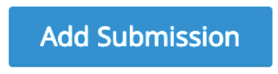

Your Steps Before Submission
Are you ready to submit?
Is it all your own work? Did you check all requirements?
Pressing this button on Moodle means you understand the rules and agree that you followed them
1
Learn about Academic Integrity
2
Seek support
from lecturers or academic advisor
3
4

Slide 4






After Submission, We…
Plagiarism check
Collusion check
Contract cheating check
1
2
Assignment received
Academic Integrity checks completed
Misconduct Identified
Investigation commences
No Issues
Assignment marked

Slide 5
“I lost marks because I copied text from a website without referencing.”
Past student experience

Slide 6
“I received a zero because my friend and I submitted the same work for an individual assignment.”
Past student experience

Slide 7
“I got some of my calculation solutions from a website and then failed my unit for cheating.”
Past student experience

Slide 8









Losing marks for an assessment
Plagiarism
0%
Receiving a zero grade
Collusion
Losing your visa
Losing your professional accreditation
Contract
cheating
Failing a unit
Blackmailed by cheating services further in your career
Being excluded

Slide 9

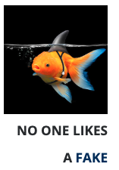
KEEP IT REAL

